Slide 1
South Carolina Energy Demand, Generation, and Weather
Ethan Lewis
December 4, 2023

Slide 2
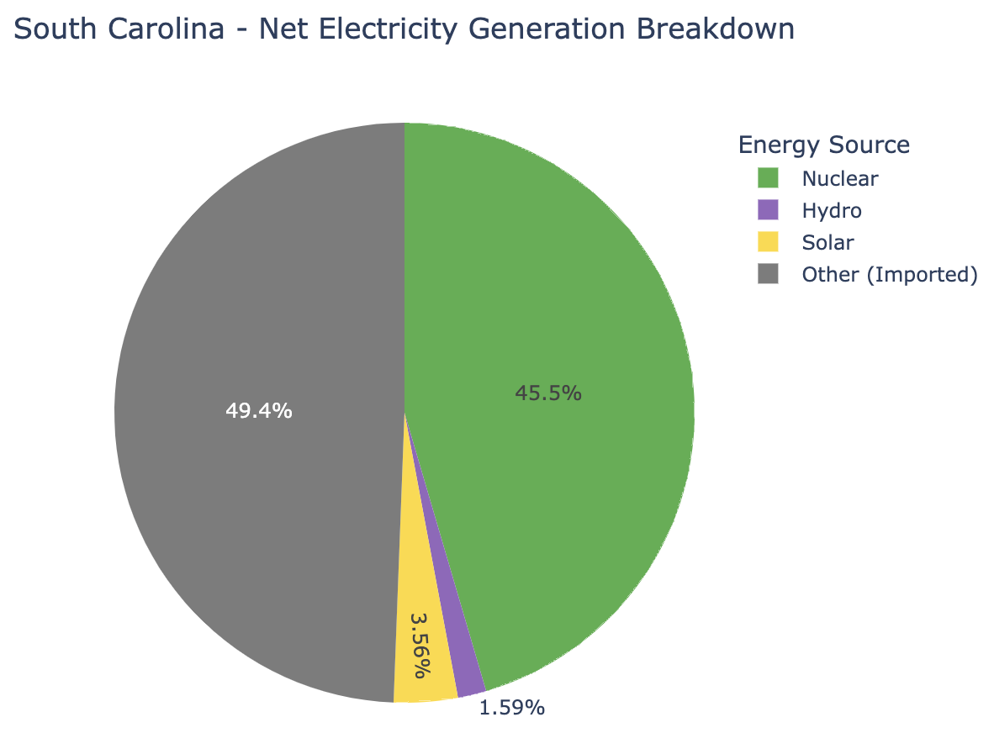
Introduction
Major Electricity Generating Raw Materials
Coal
Natural Gas
Petroleum
Nuclear Energy
Hydropower
Solar Energy
How do weather patterns affect in-state electricity demand and generation?

Slide 3
Data Sources

Slide 4

Data Sources
Daily Energy
Net, Nuclear, Solar, and Hydropower Generation (MWh)
Demand (MWh)

Slide 5


Data Sources
Daily Energy
Net, Nuclear, Solar, and Hydropower Generation (MWh)
Demand (MWh)
Daily Weather
Weather Station Coordinates
Average Temperature (°F)
Sunshine Duration (sec.)
Total Shortwave Radiation (MJ/m²)
Total Precipitation (mm.)
Total Precipitation Time (hrs.)
Total Evapotranspiration (mm.)
WMO Weather Code
Weather Description

Slide 6
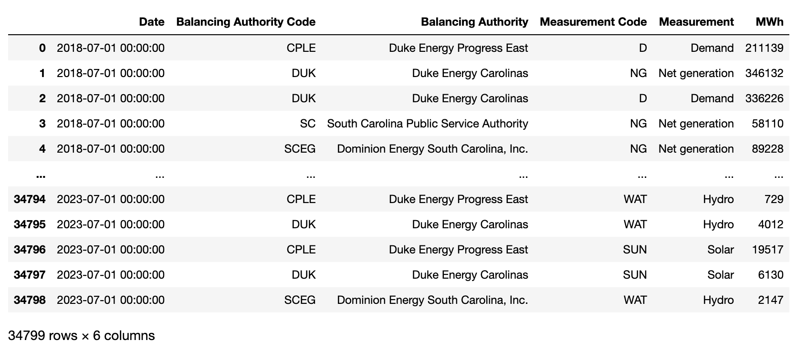
Daily Energy Data
API Calls
Parameters
Date
Balancing Authority
Measurement Type

Slide 7
Daily Energy Data
API Calls
Parameters
Date
Balancing Authority
Measurement Type

Slide 8
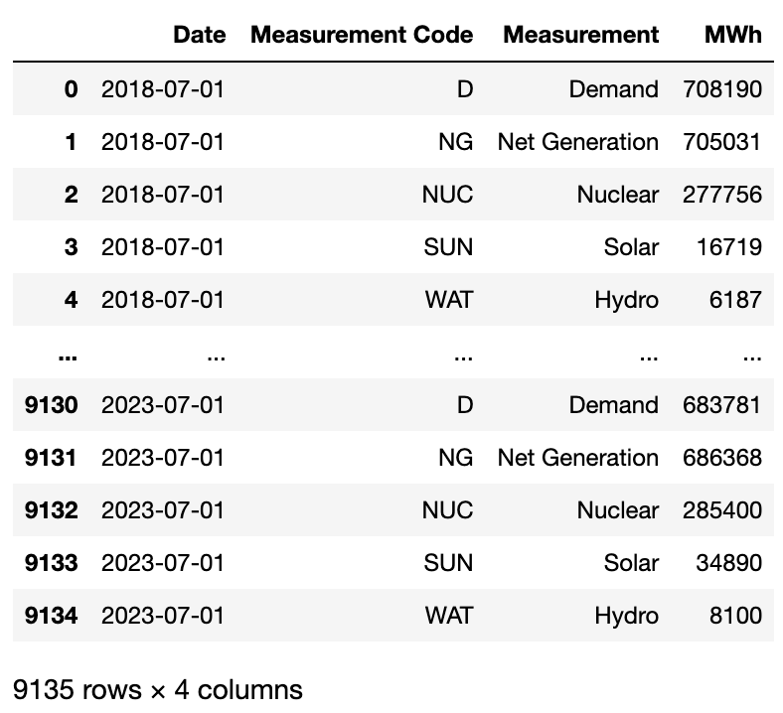
Daily Energy Data cont’d.
Data Cleaning
Sum MWh grouped by Date and Measurement.
Each Date + Measurement pair has one MWh value.
Remove “00:00:00” from Date values.
Remove Balancing Authority columns.
Capitalize “Net Generation” in Measurement column.

Slide 9
Daily Energy Data cont’d.
Data Cleaning
Sum MWh grouped by Date and Measurement.
Each Date + Measurement pair has one MWh value.
Remove “00:00:00” from Date values.
Remove Balancing Authority columns.
Capitalize “Net Generation” in Measurement column.

Slide 10
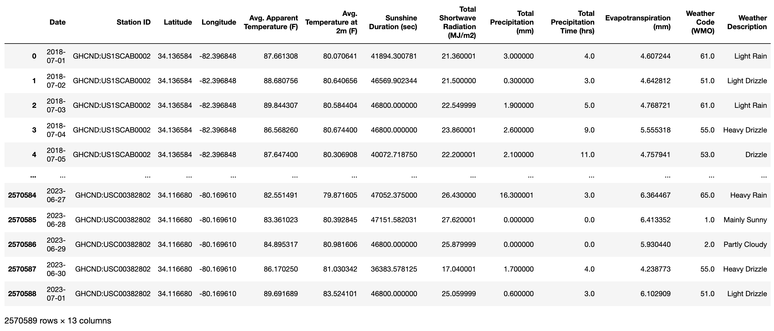
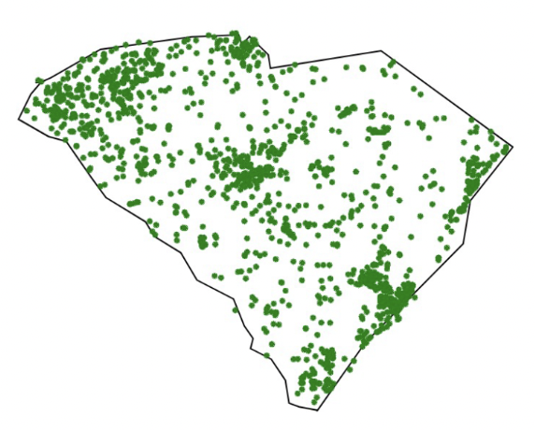
Daily Weather Data
API Calls
NOAA API Call
Access SC weather station Latitude and Longitude.
Open-Meteo API Call
Use Latitude and Longitude values to access local weather data.
Weather Station

Slide 11
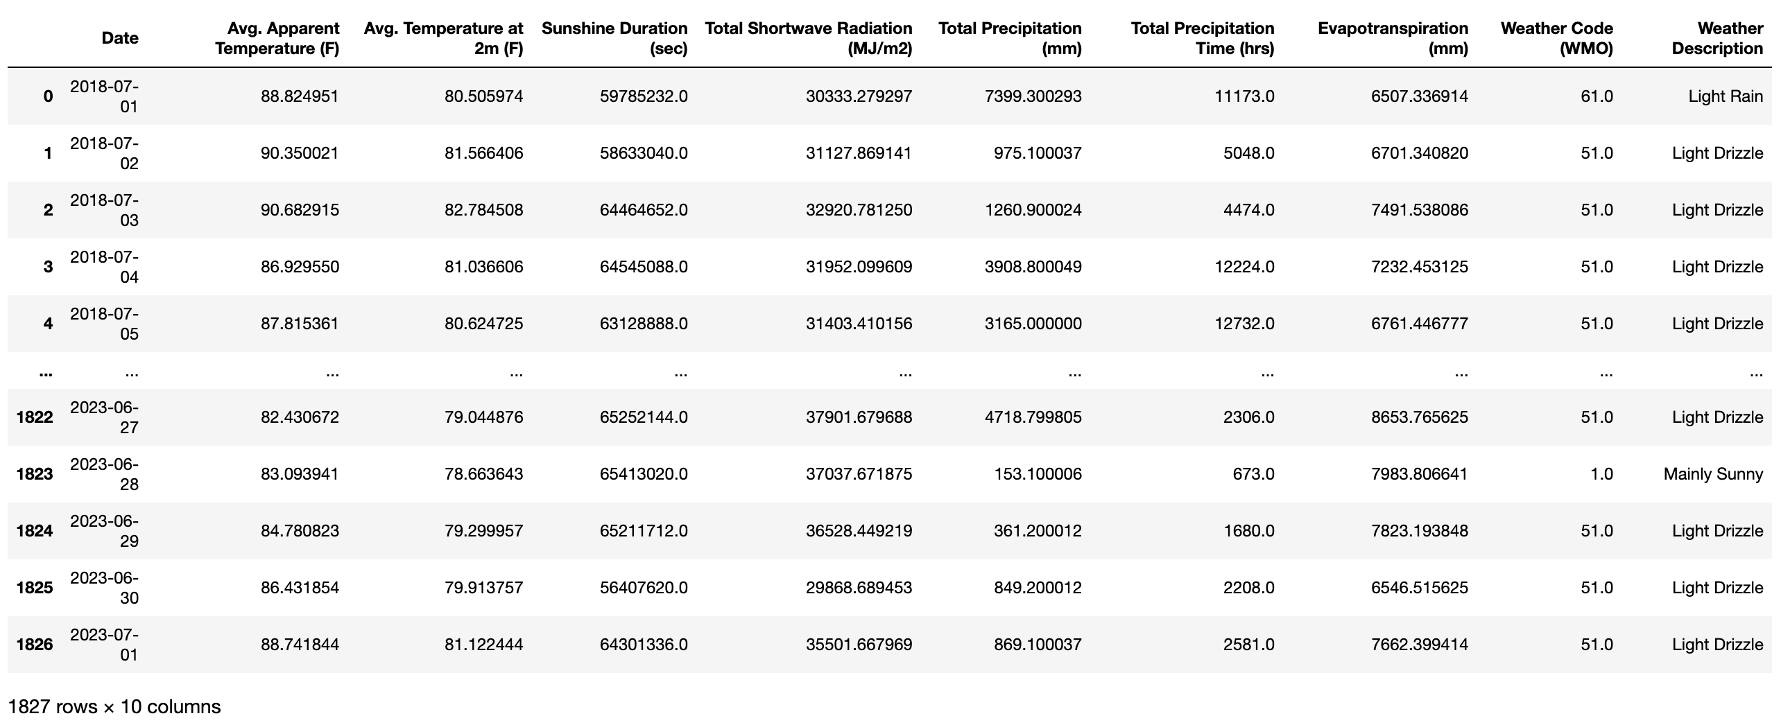
Daily Weather Data cont’d.
Data Cleaning
Aggregate weather measurements grouped by Date*.
Each Date has one set of weather measurements
Drop Station ID, Latitude, and Longitude columns.
*
Averaged
Summed
Frequency

Slide 12
Daily Weather Data cont’d.
Data Cleaning
Aggregate weather measurements grouped by Date*.
Each Date has one set of weather measurements
Drop Station ID, Latitude, and Longitude columns.
*
Averaged
Summed
Frequency

Slide 13
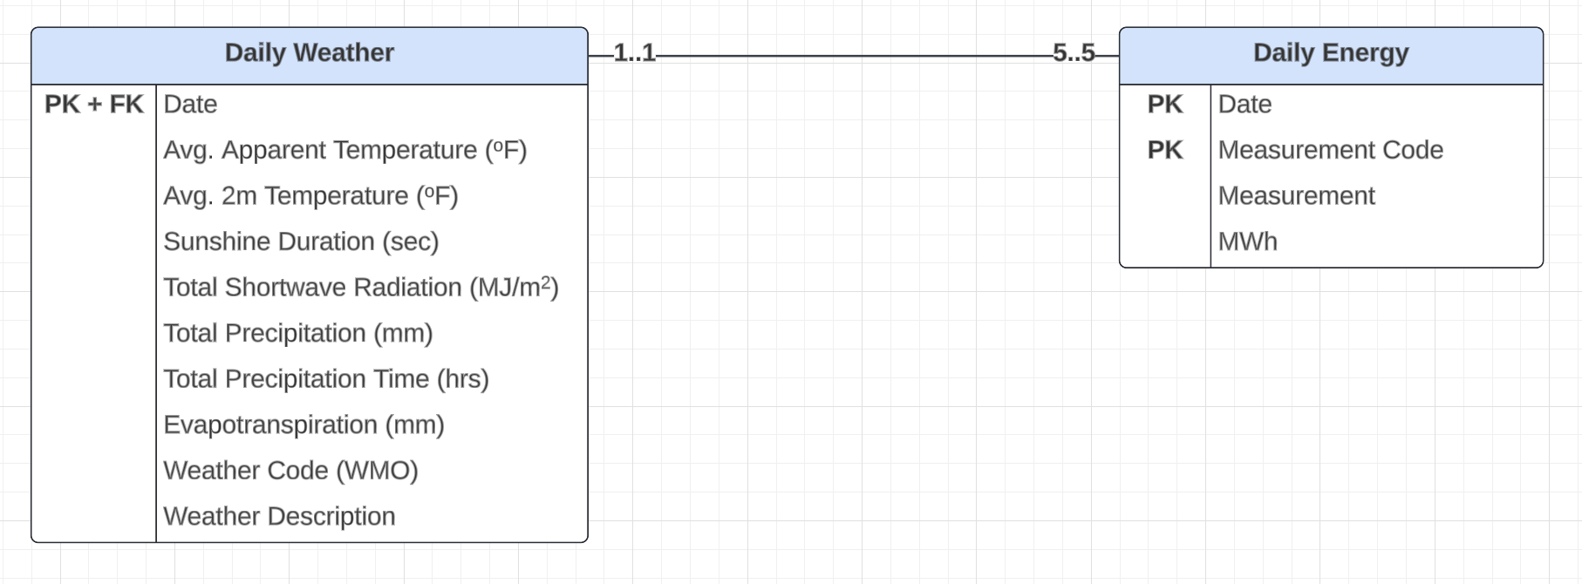
SQL Database Organization

Slide 14
SQL Database Organization

Slide 15
SQL Database Organization

Slide 16
Data Visualizations

Slide 17
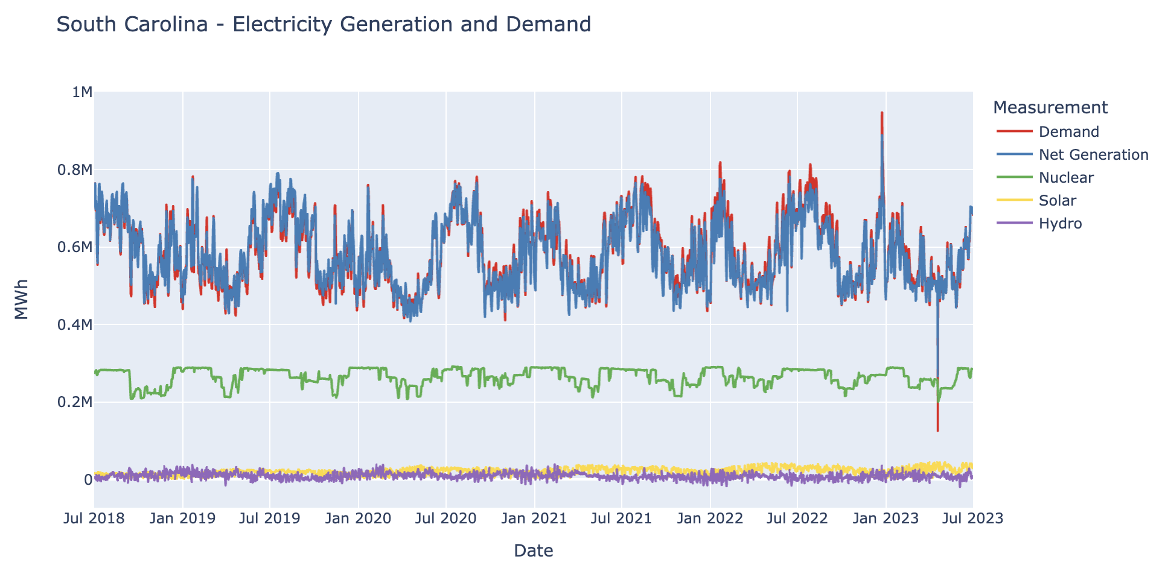

Slide 18
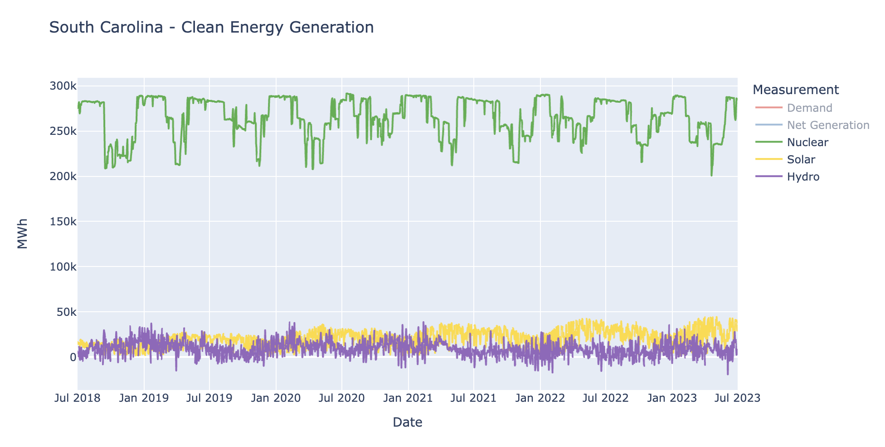

Slide 19
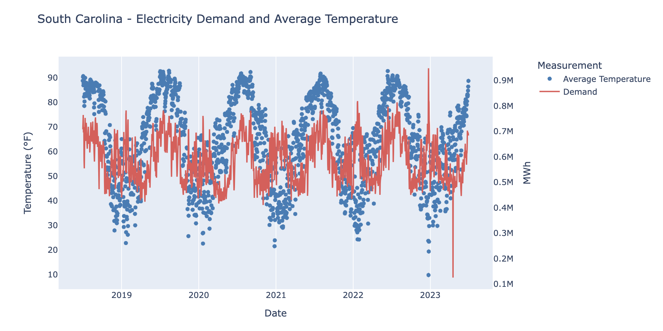

Slide 20
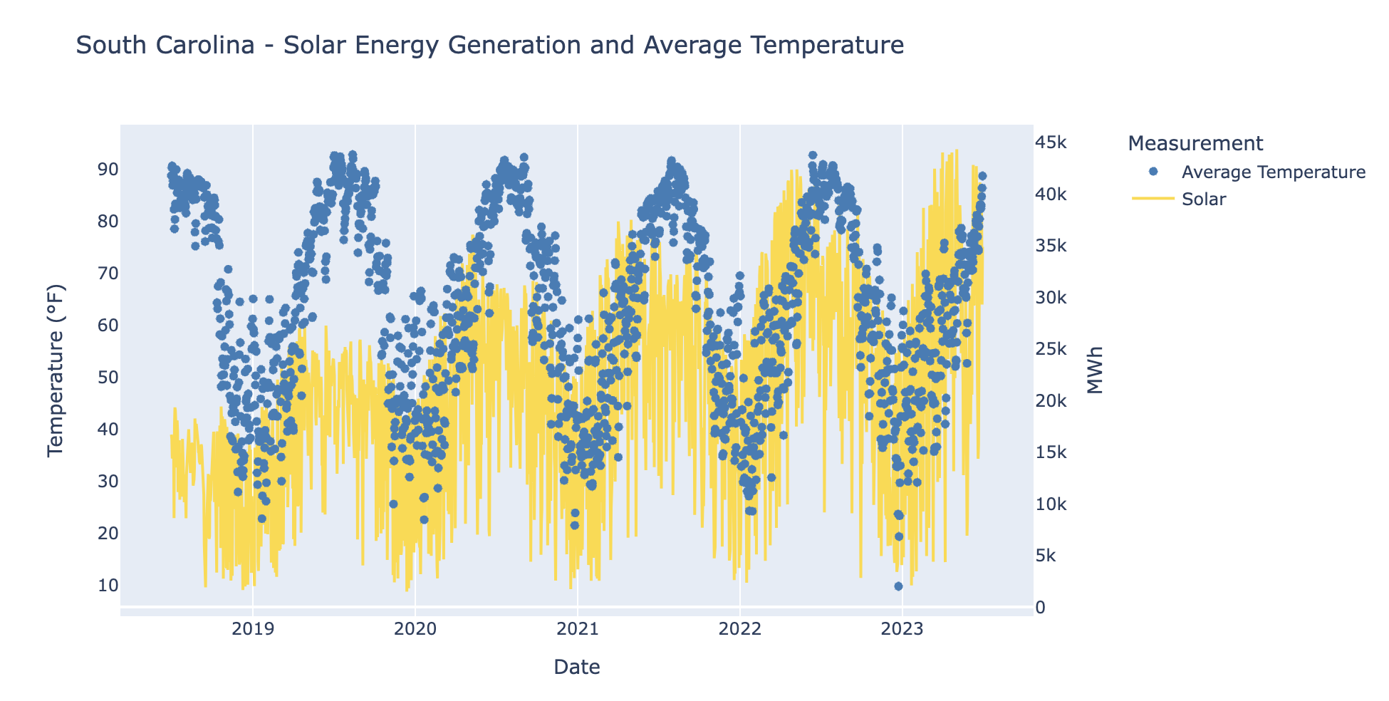

Slide 21
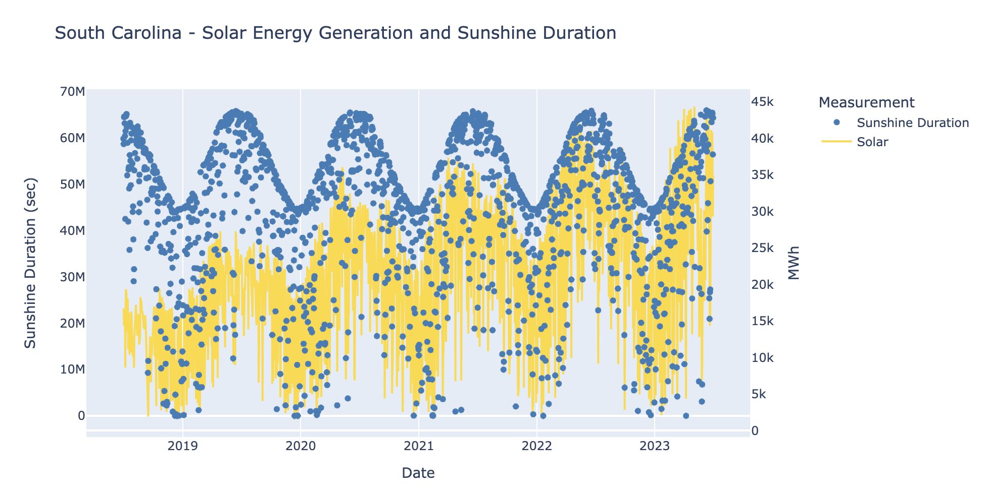

Slide 22
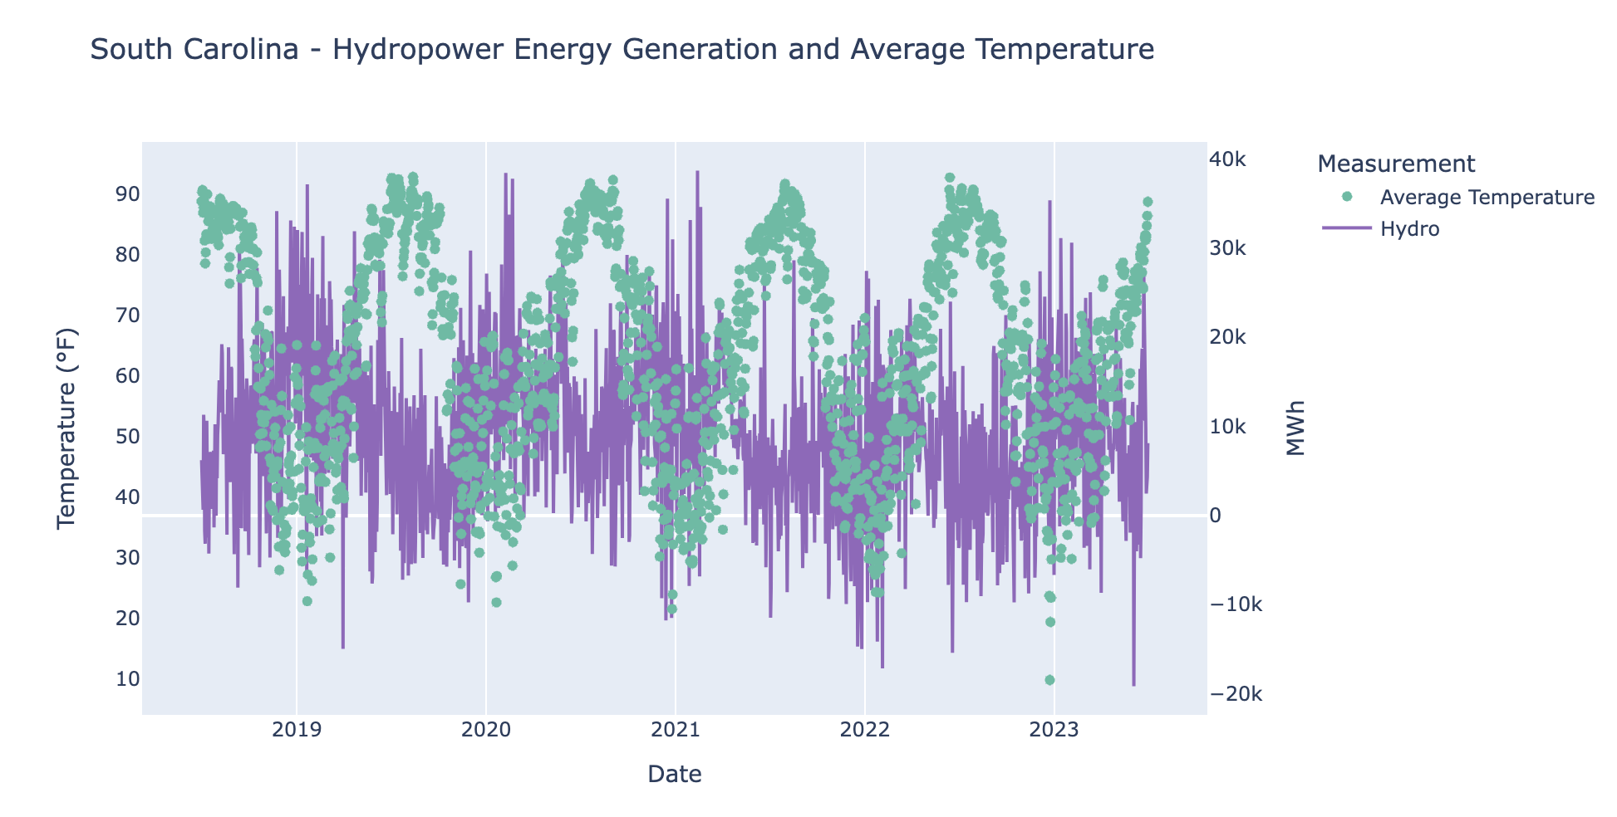

Slide 23
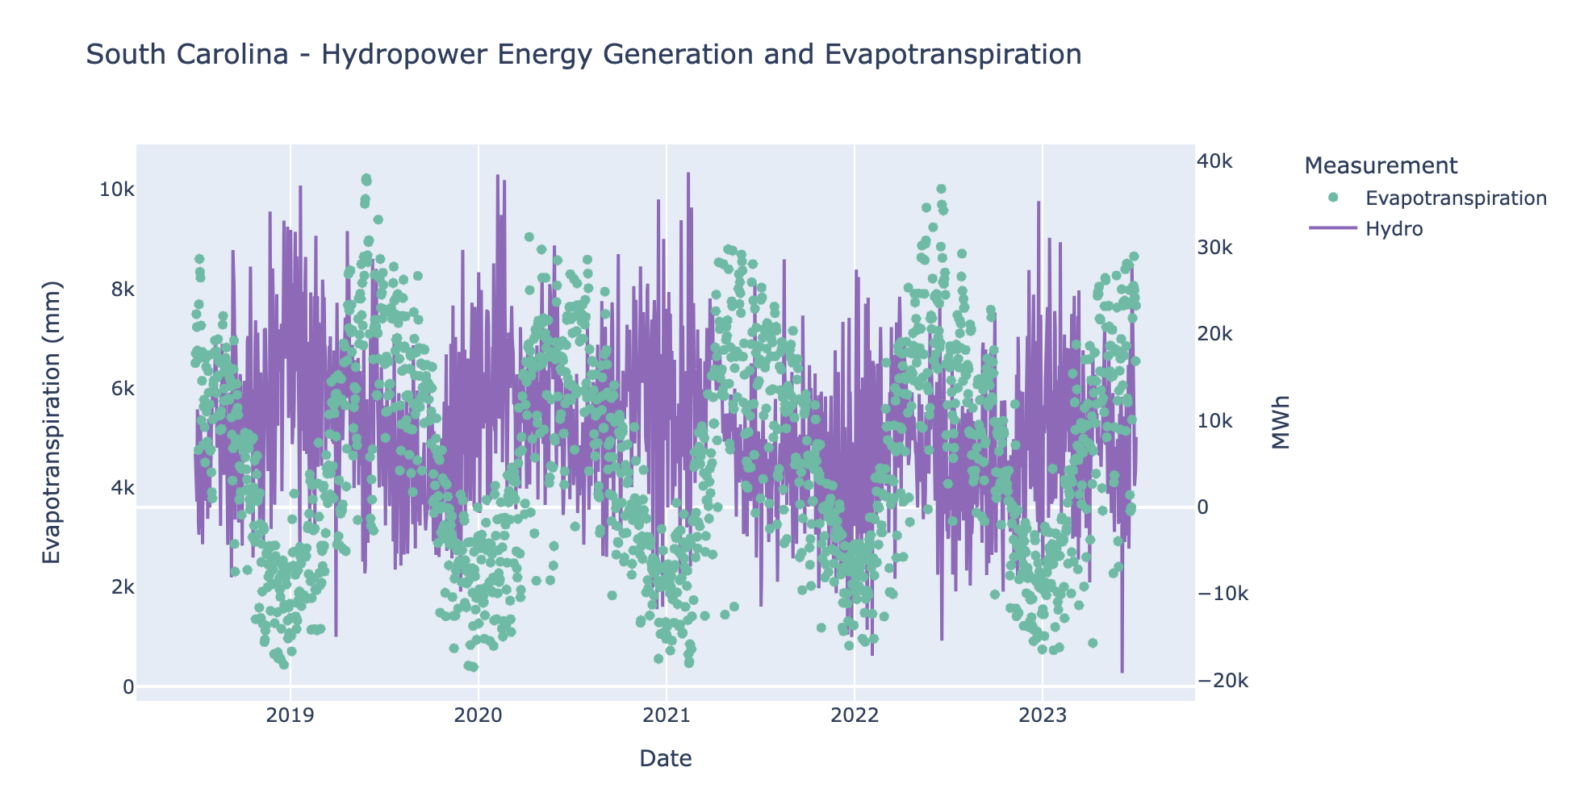

Slide 24
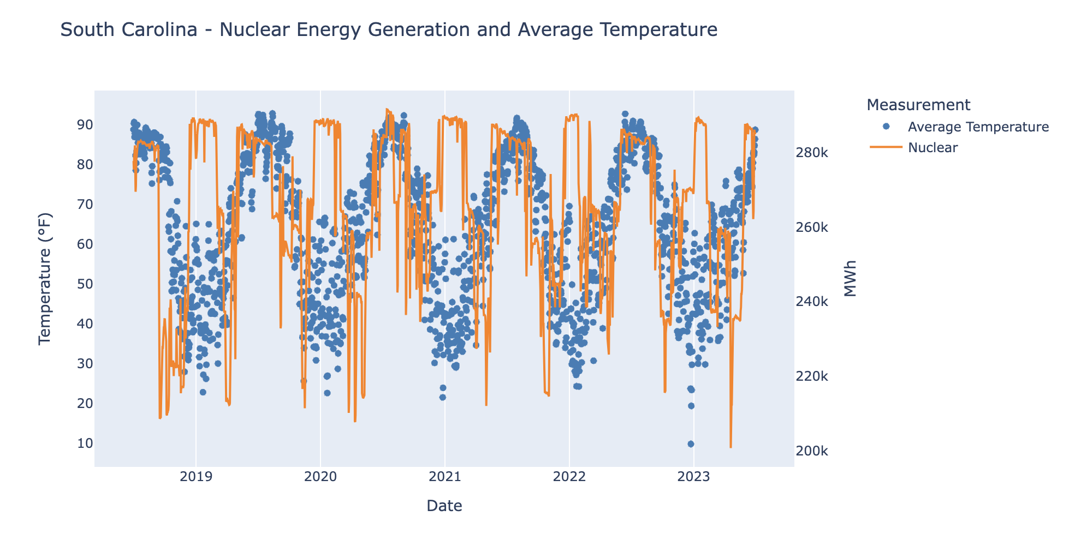

Slide 25
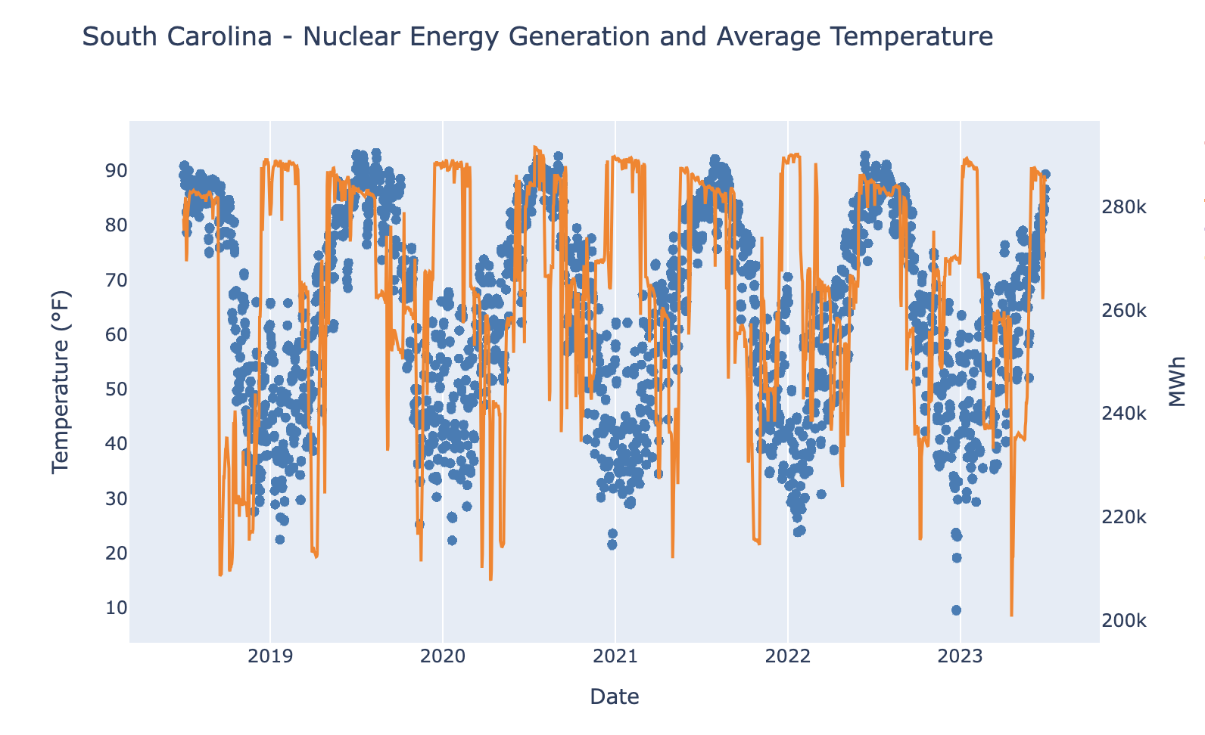
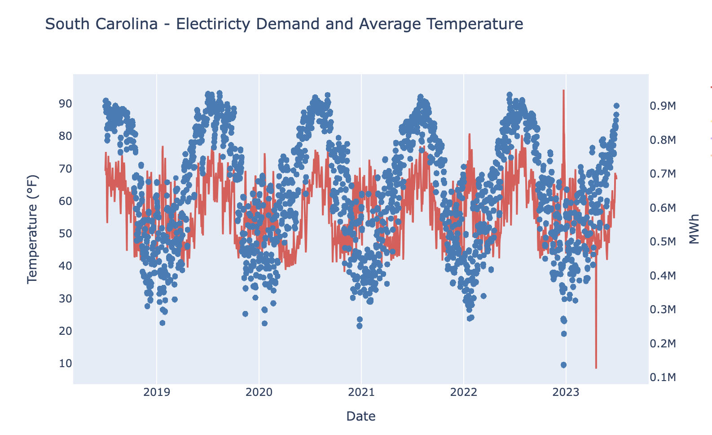
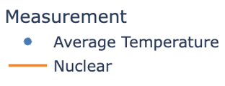
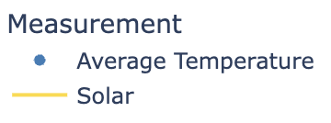
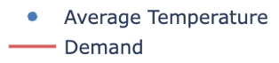

Slide 26
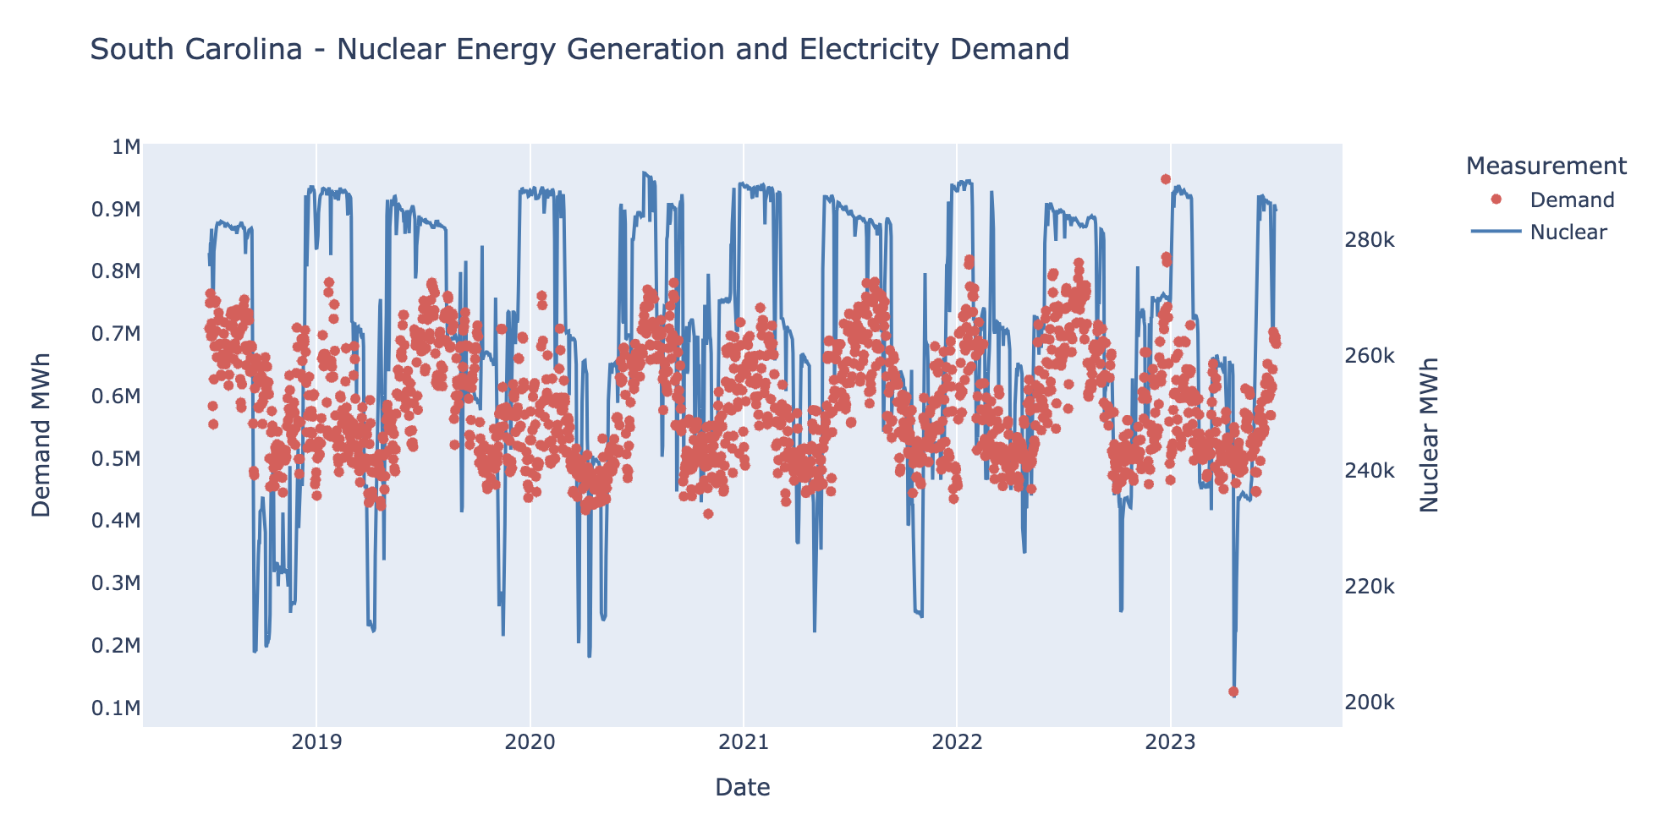

Slide 27
Summary and Conclusions

Slide 28
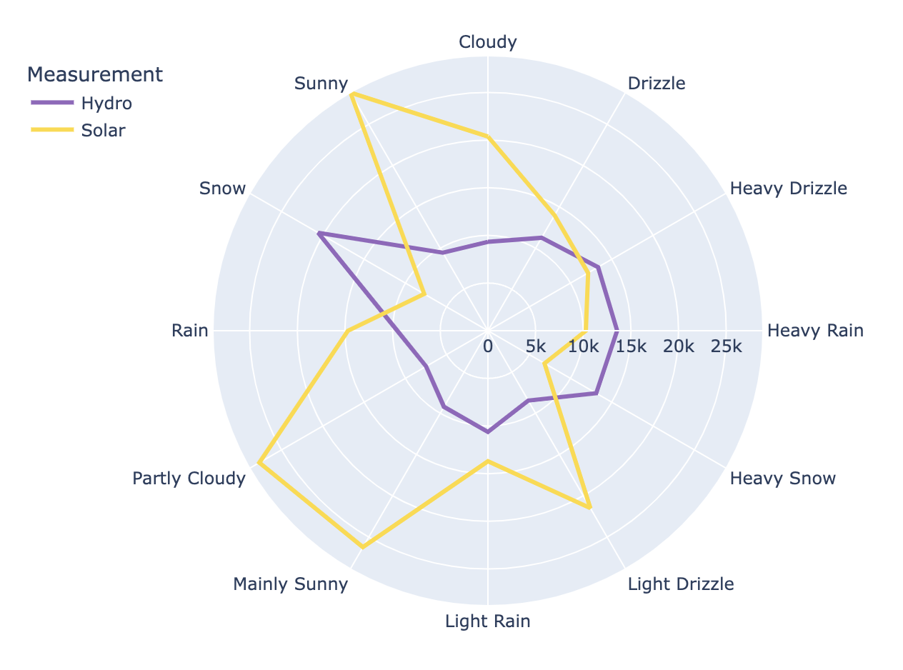
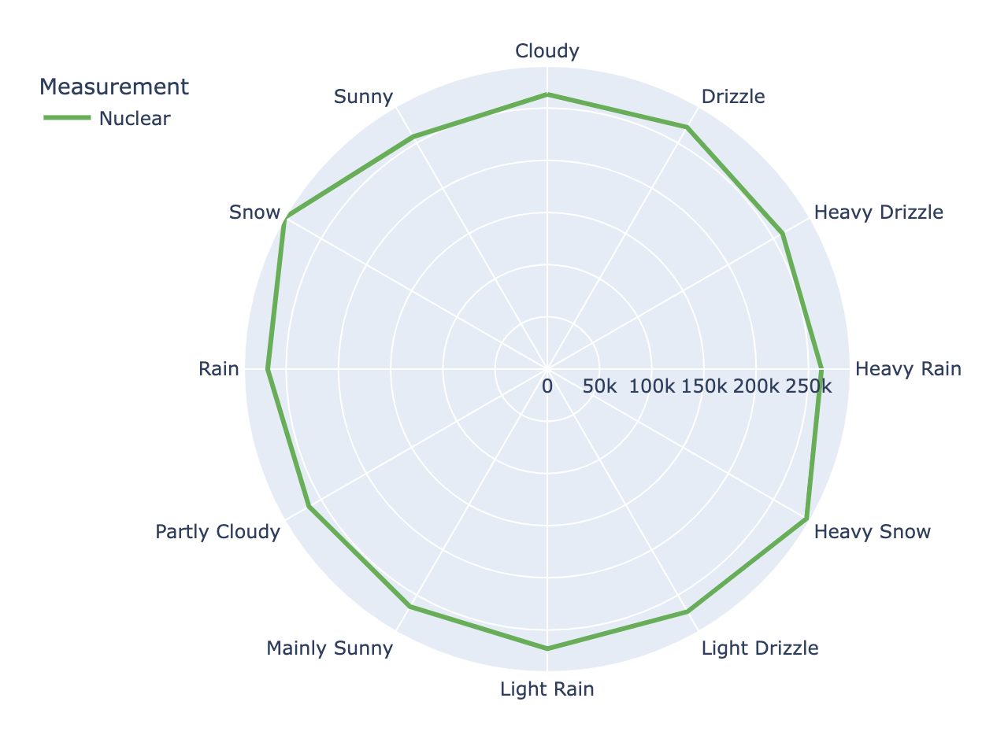
Summary

Slide 29
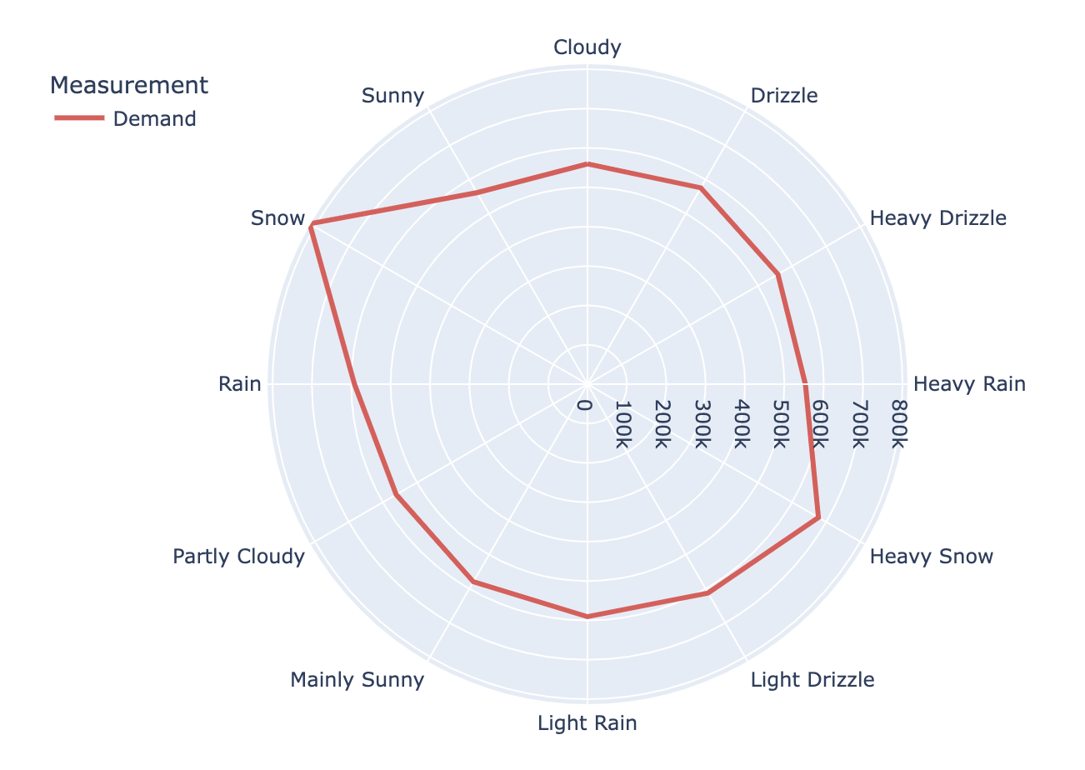
Conclusion

Slide 30
Works Cited
US Energy Information Administration – EIA. “Open Data – Application Programming Interface”. https://www.eia.gov/opendata/index.php. Accessed 27 October 2023.
National Oceanic and Atmospheric Administration – NOAA. “Climate Data Online: Web Services v2”. https://www.ncdc.noaa.gov/cdo-web/webservices/v2?ref=grantwinney.com#gettingStarted. Accessed 5 November 2023.
Open-Meteo. “Historical Weather API”. https://open-meteo.com/en/docs/historical-weather-api. Accessed 18 November 2023.
US Energy Information Administration – EIA. “South Carolina – State Profile and Energy Estimates”. (19 January 2023). https://www.eia.gov/state/analysis.php?sid=SC. Accessed 28 October 2023.
South Carolina Energy Office. “South Carolina Energy Landscape”. (4 December 2023). https://south-carolina-energy-office-1-1-scors-eo.hub.arcgis.com/pages/electricity-data. Accessed 28 October 2023.
US Energy Information Administration – EIA. “Frequently Asked Questions (FAQs)”. https://www.eia.gov/tools/faqs/faq.php?id=104&t=3#:~:text=U.S.%20nuclear%20power%20plants%20reduce,when%20electricity%20demand%20is%20lower. Accessed 1 December 2023.
McKinney, W., & others. (2010). Data structures for statistical computing in python. In Proceedings of the 9th Python in Science Conference (Vol. 445, pp. 51–56).
Kelsey Jordahl, Joris Van den Bossche, Martin Fleischmann, Jacob Wasserman, James McBride, Jeffrey Gerard, … François Leblanc. (2020, July 15). geopandas/geopandas: v0.8.1 (Version v0.8.1). Zenodo. http://doi.org/10.5281/zenodo.3946761.
Plotly Technologies Inc. Collaborative data science. Montréal, QC, 2015. https://plot.ly.

